Slide 1
Deterministic
Finite Automata
Notes:
1

Slide 2
Deterministic Finite Automaton (DFA)
Input Tape
String
Output
“Accept”
or
“Reject”
Finite
Automaton

Slide 3
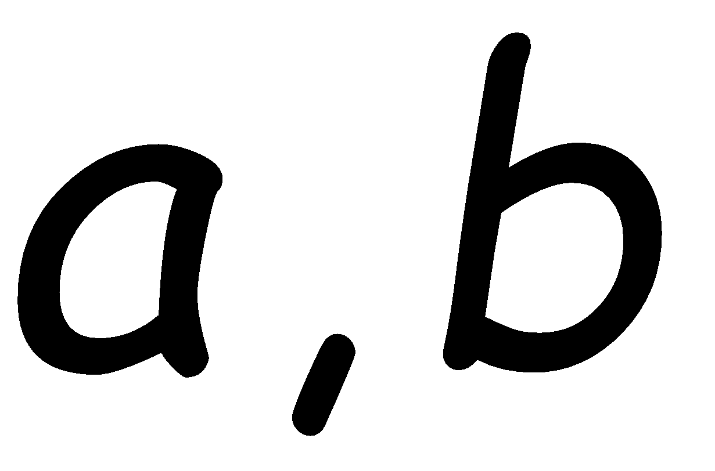
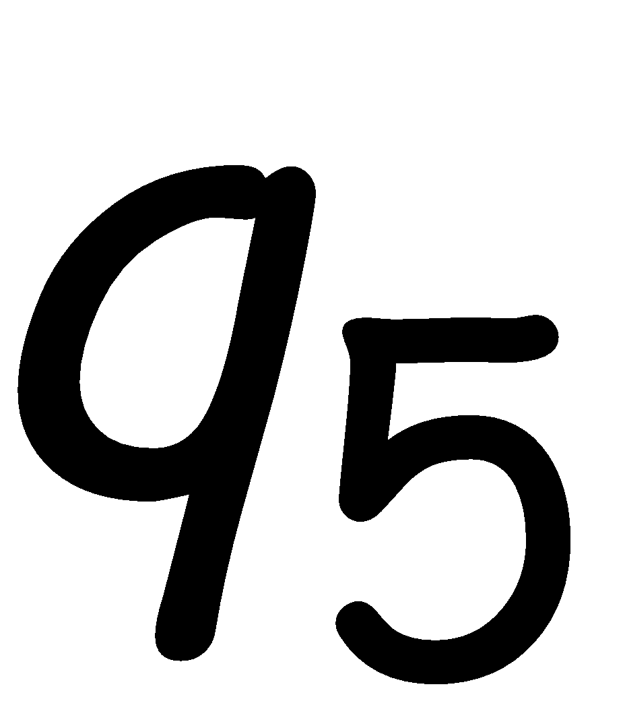
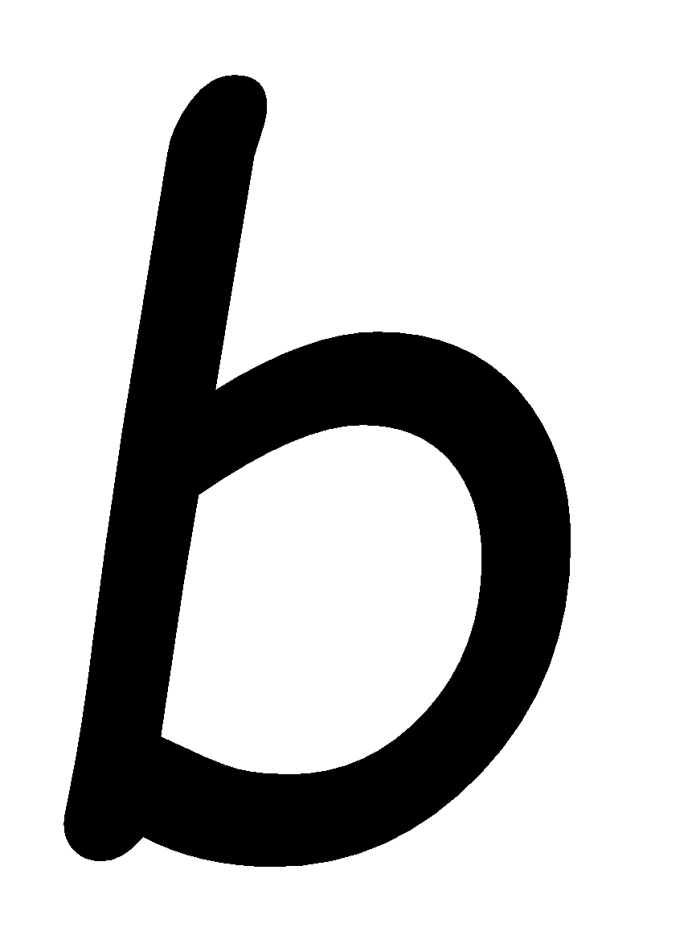
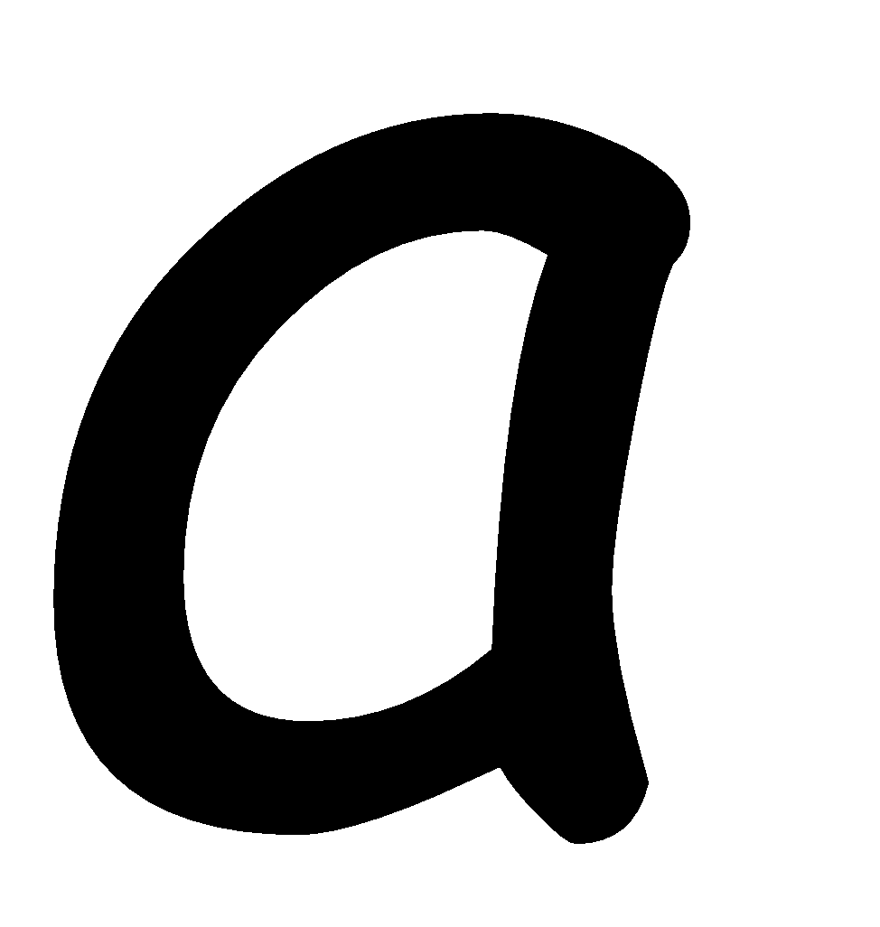
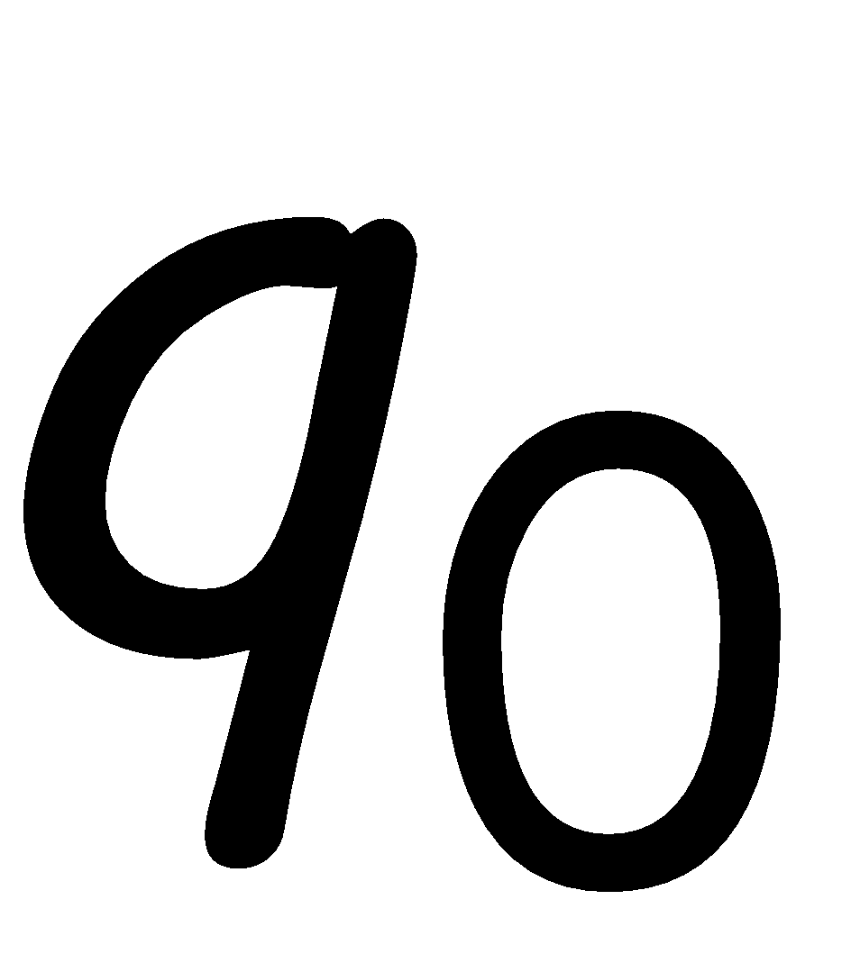
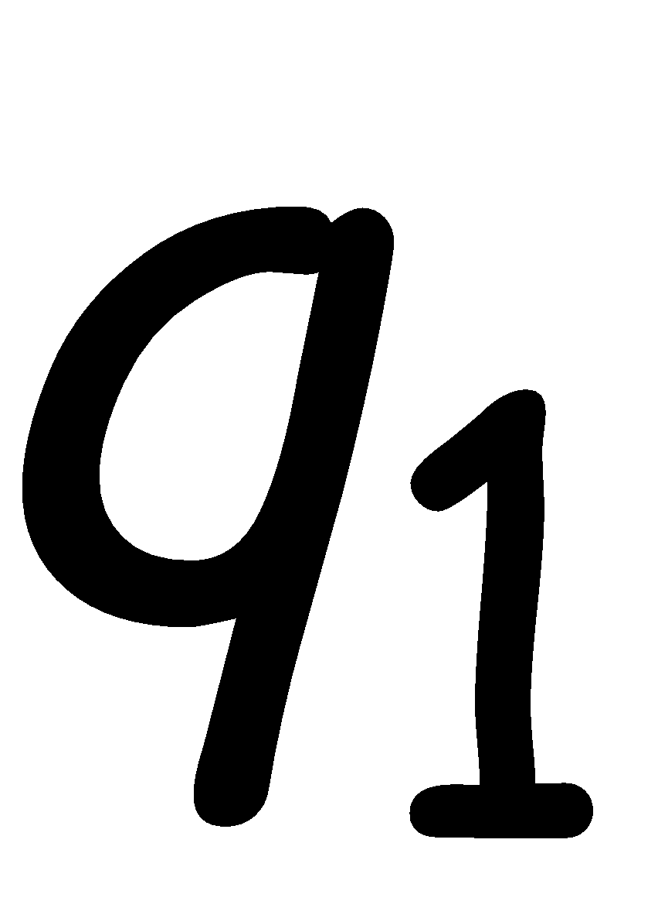
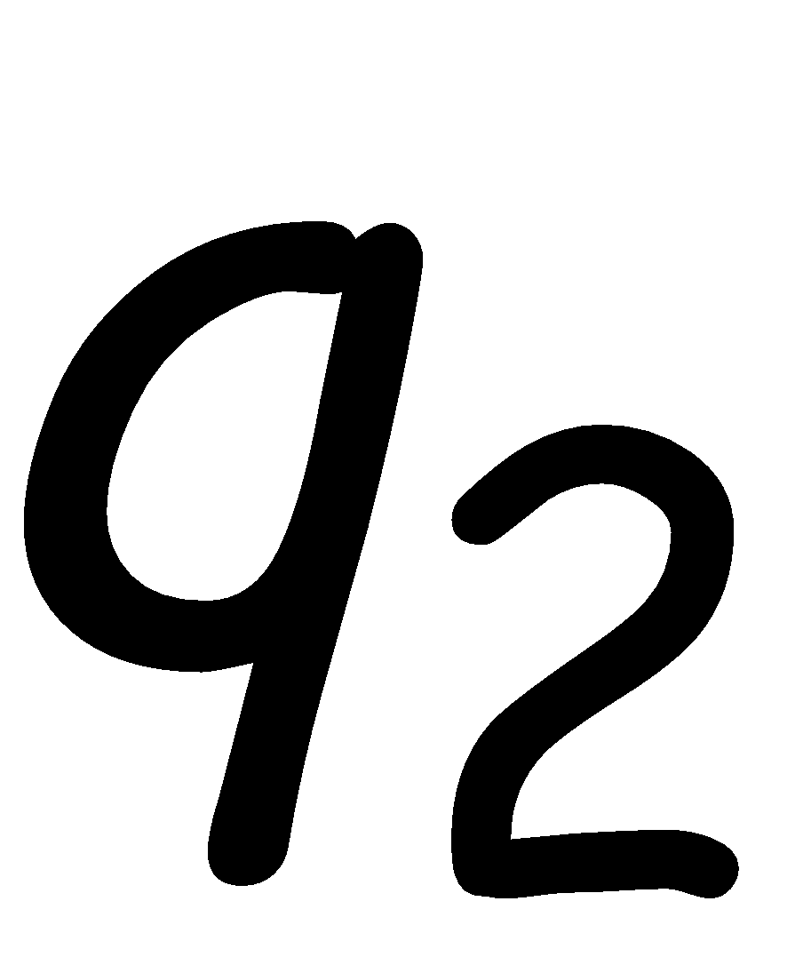
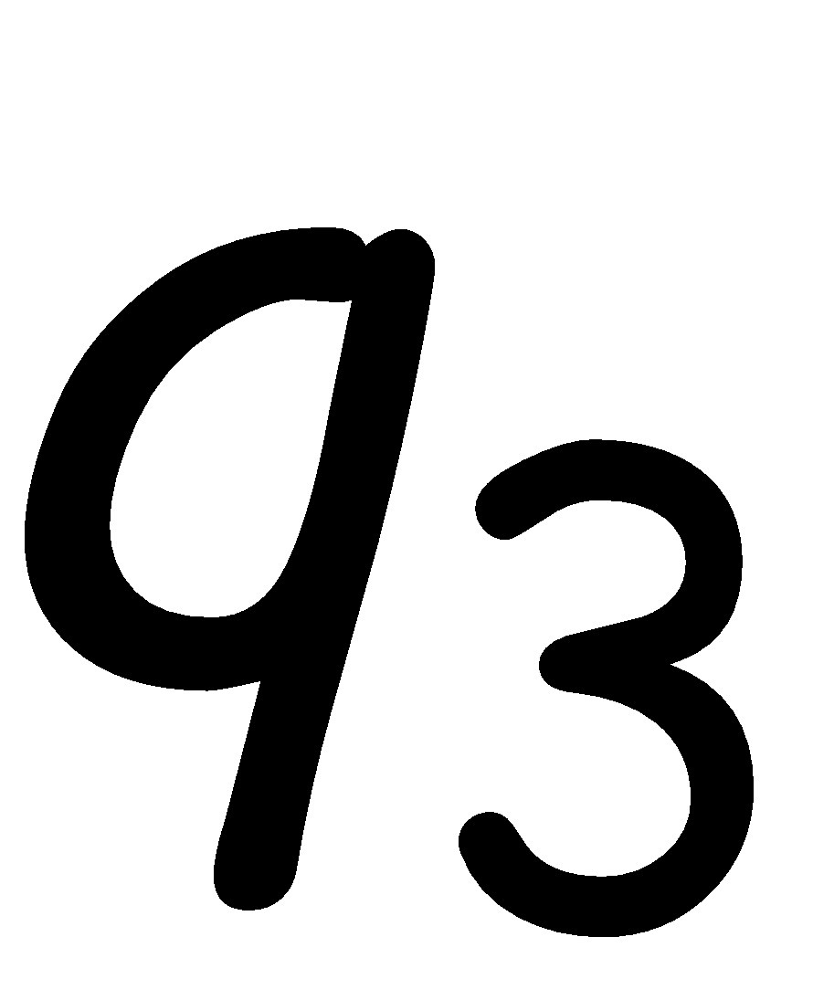
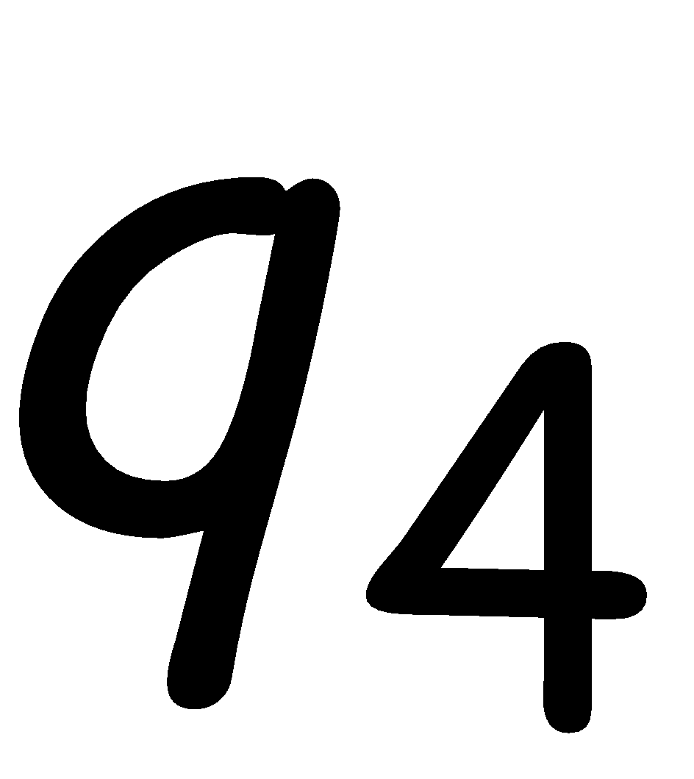
Transition Graph
initial
state
accepting
state
transition
state

Slide 4
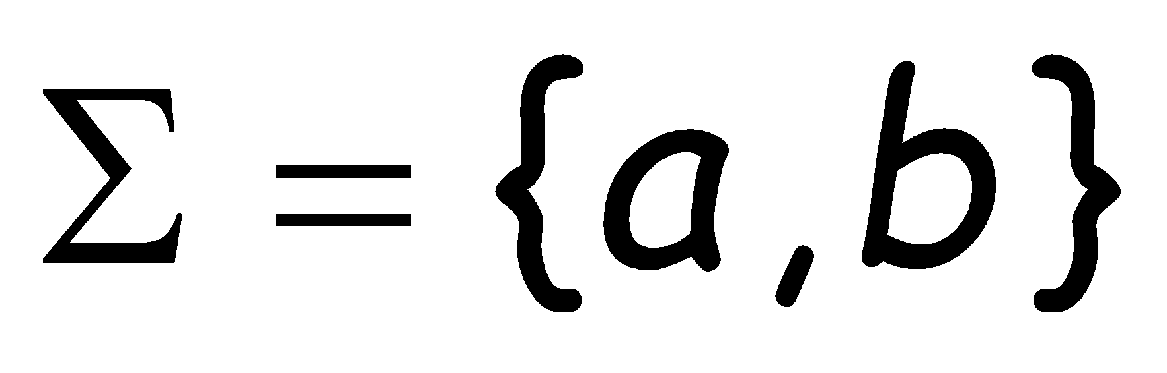
Alphabet
For every state, there is a transition
for every symbol in the alphabet

Slide 5
Initial Configuration
head
Input Tape
a
Input String
Initial state

Slide 6
Scanning the Input

Slide 9
Input finished
accept

Slide 10
A Rejection Case
Input String

Slide 13
Input finished
reject

Slide 14
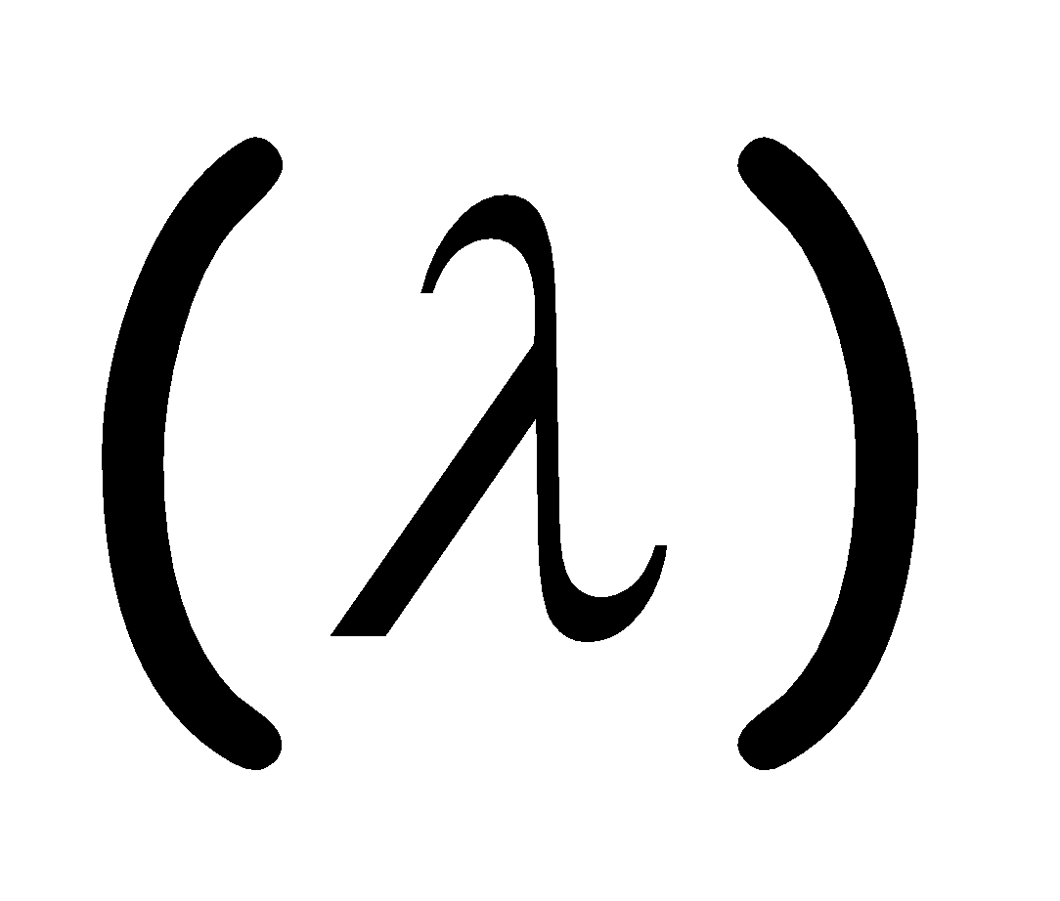
Another Rejection Case
Tape is empty
Input Finished
reject

Slide 15
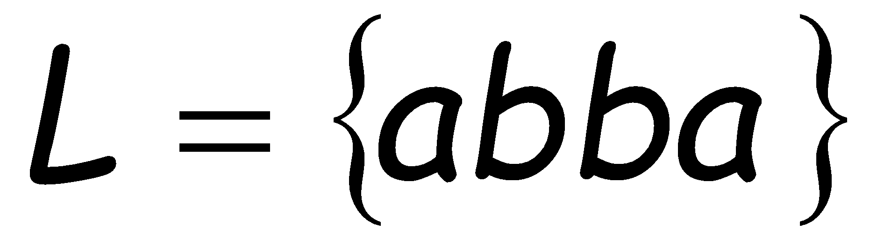
Language Accepted:

Slide 16
To accept a string:
all the input string is scanned
and the last state is accepting
To reject a string:
all the input string is scanned
and the last state is non-accepting

Slide 17
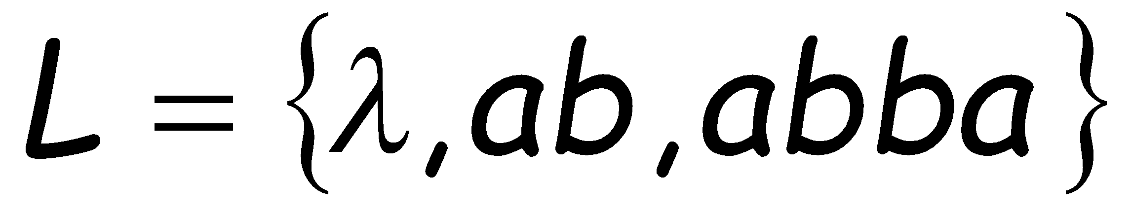
Another Example
Accept
state
Accept
state
Accept
state

Slide 18
Empty Tape
Input Finished
accept

Slide 19
Another Example
Accept
state
trap state

Slide 20
Input String

Slide 23
Input finished
accept

Slide 24
A rejection case
Input String

Slide 27
Input finished
reject

Slide 28
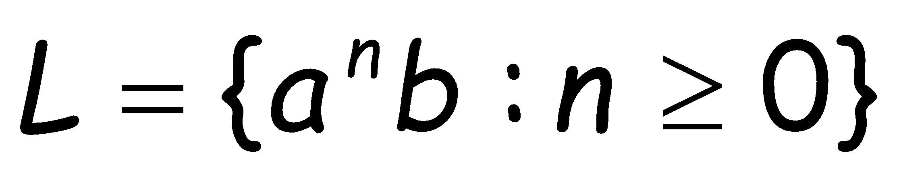
Language Accepted:

Slide 29
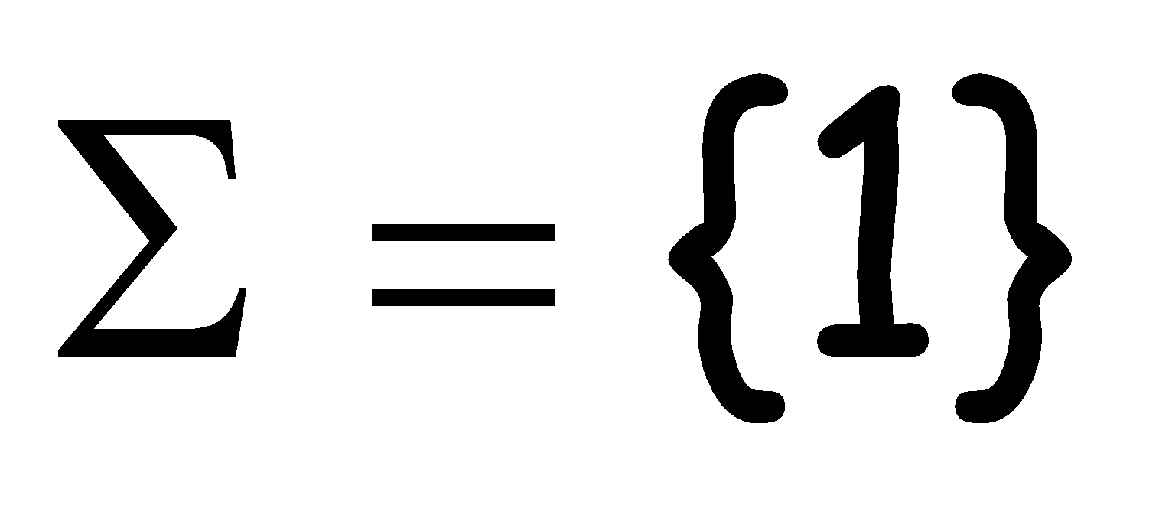

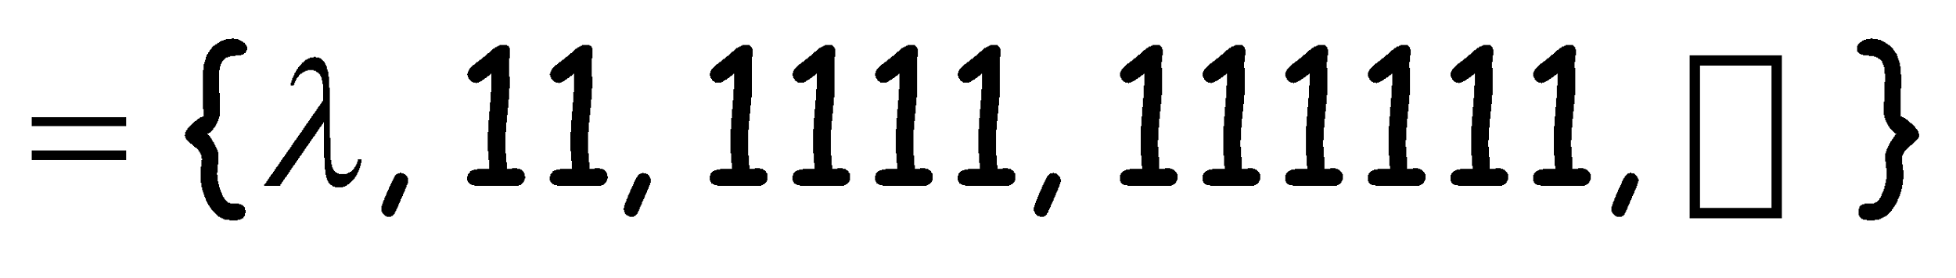
Another Example
Alphabet:
Language Accepted:

Slide 30
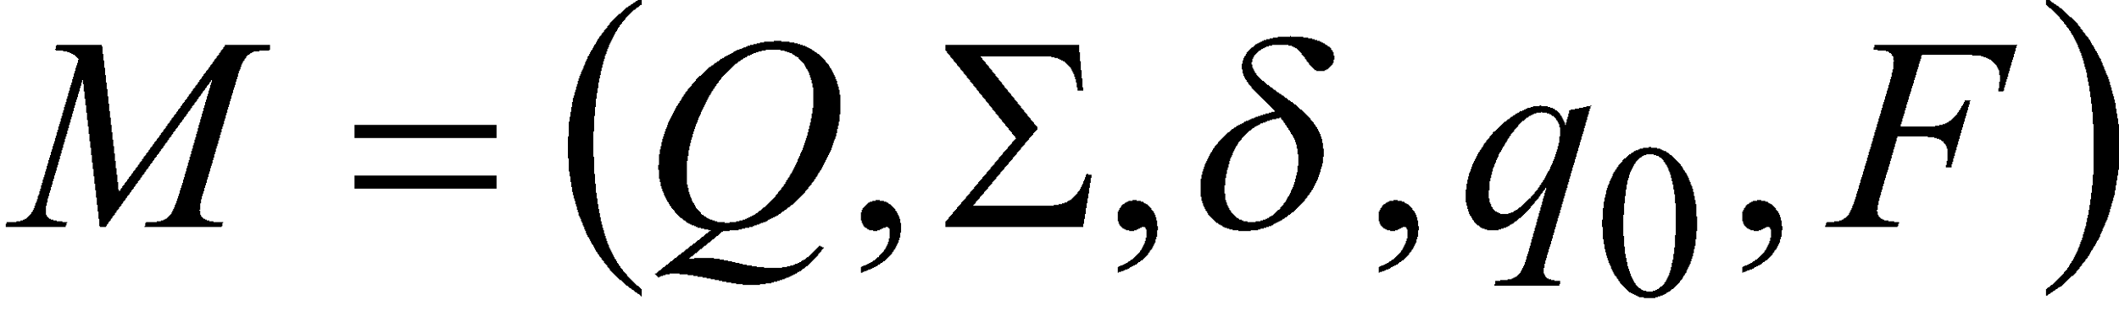


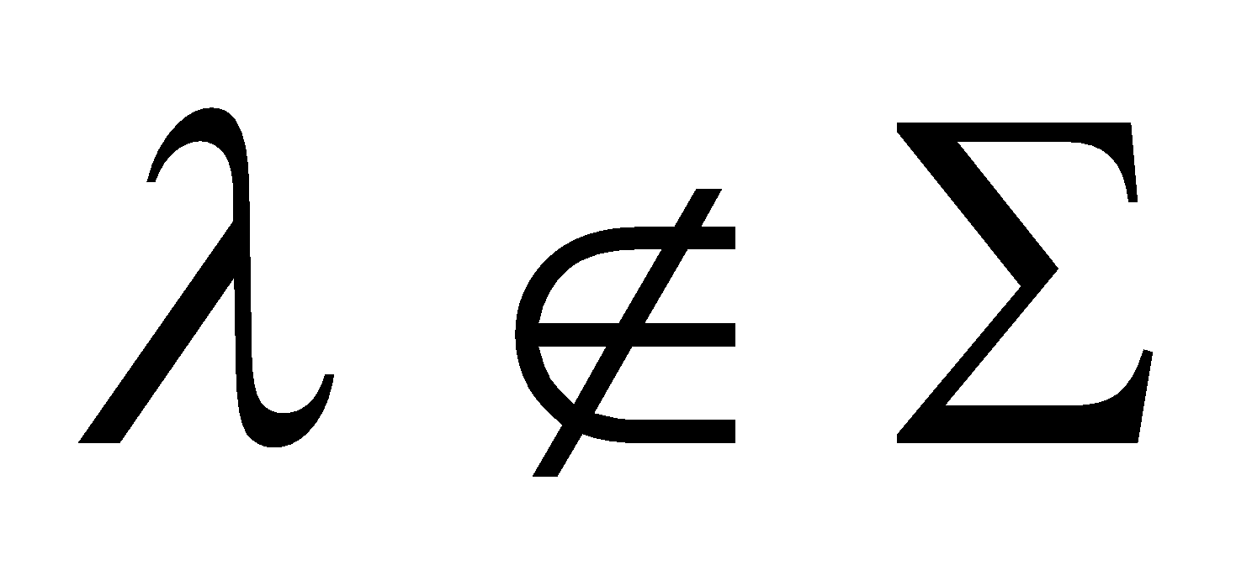
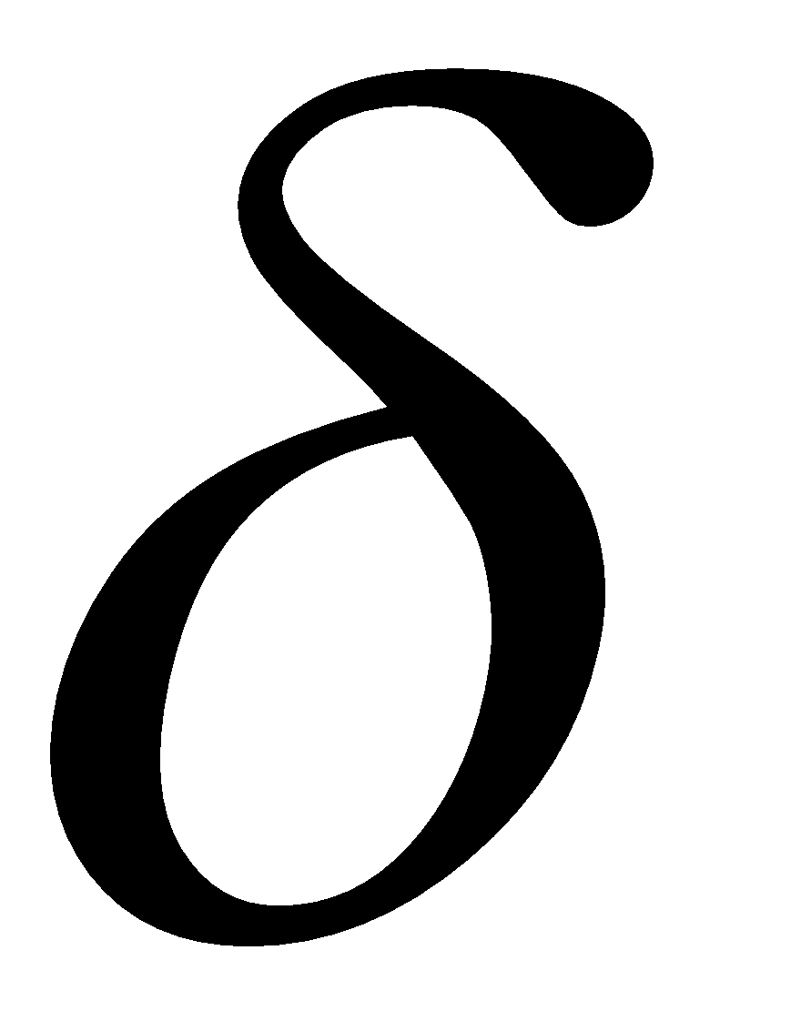
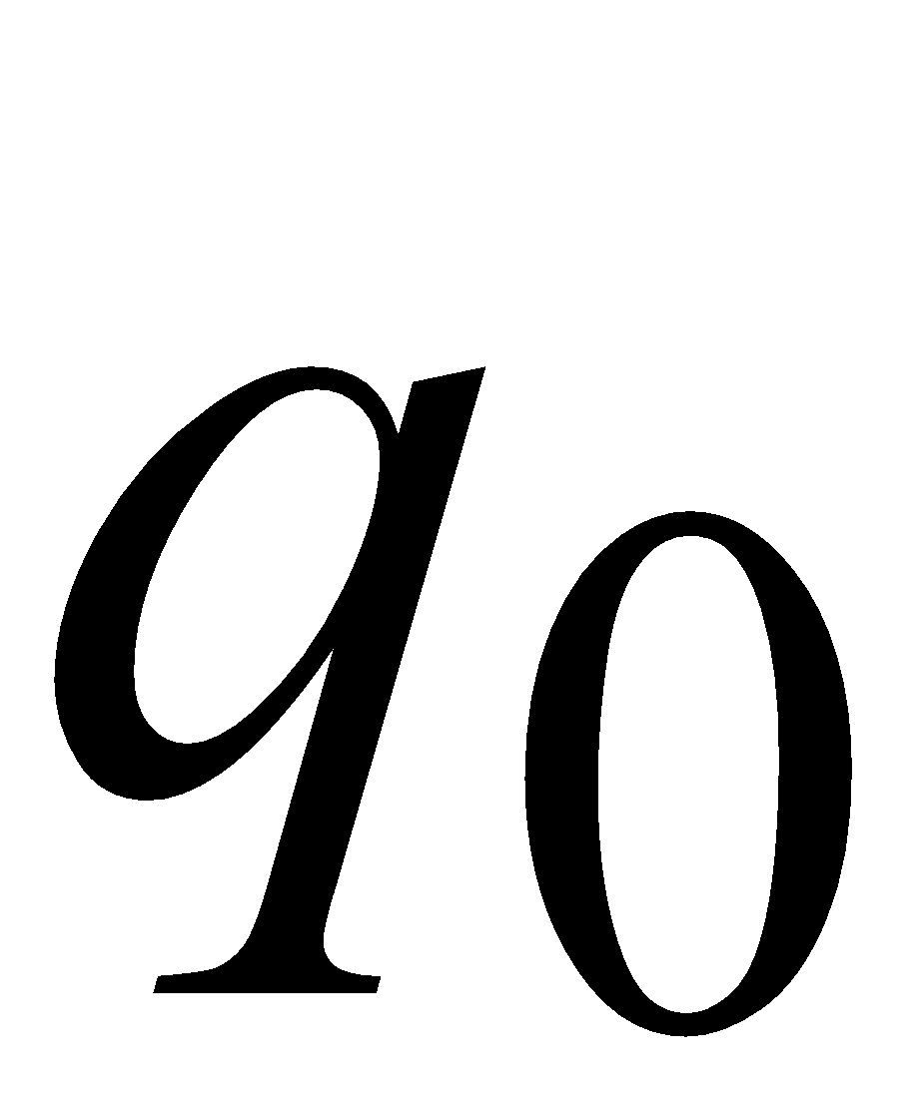

Formal Definition
Deterministic Finite Automaton (DFA)
: set of states
: input alphabet
: transition function
X →
: initial state
: set of accepting states

Slide 31
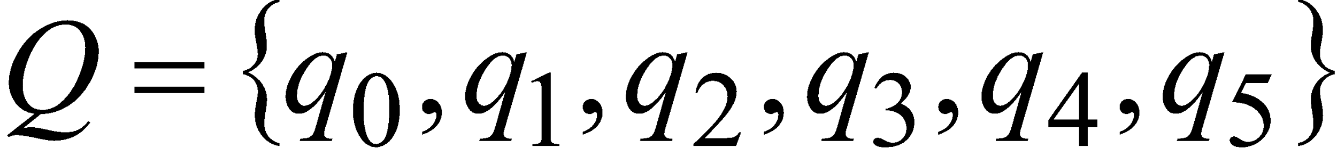
Set of States
Example

Slide 32
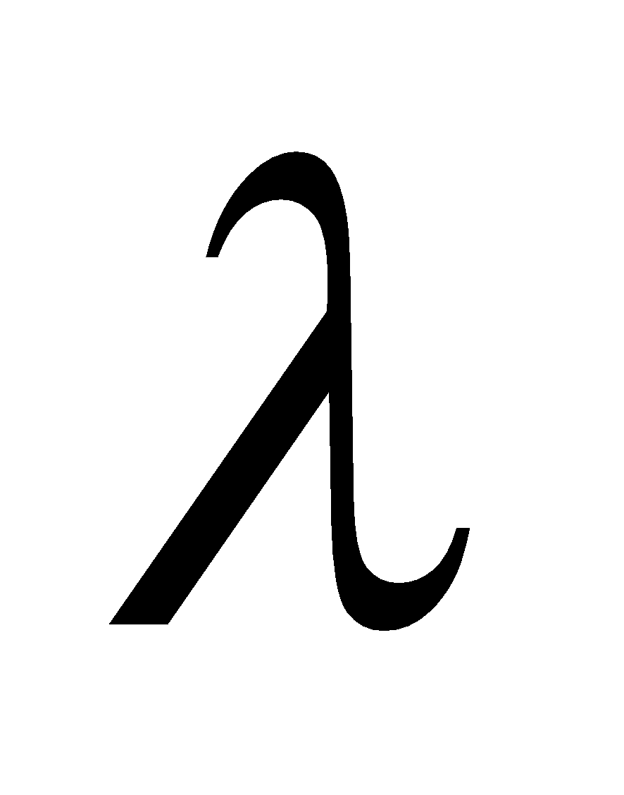
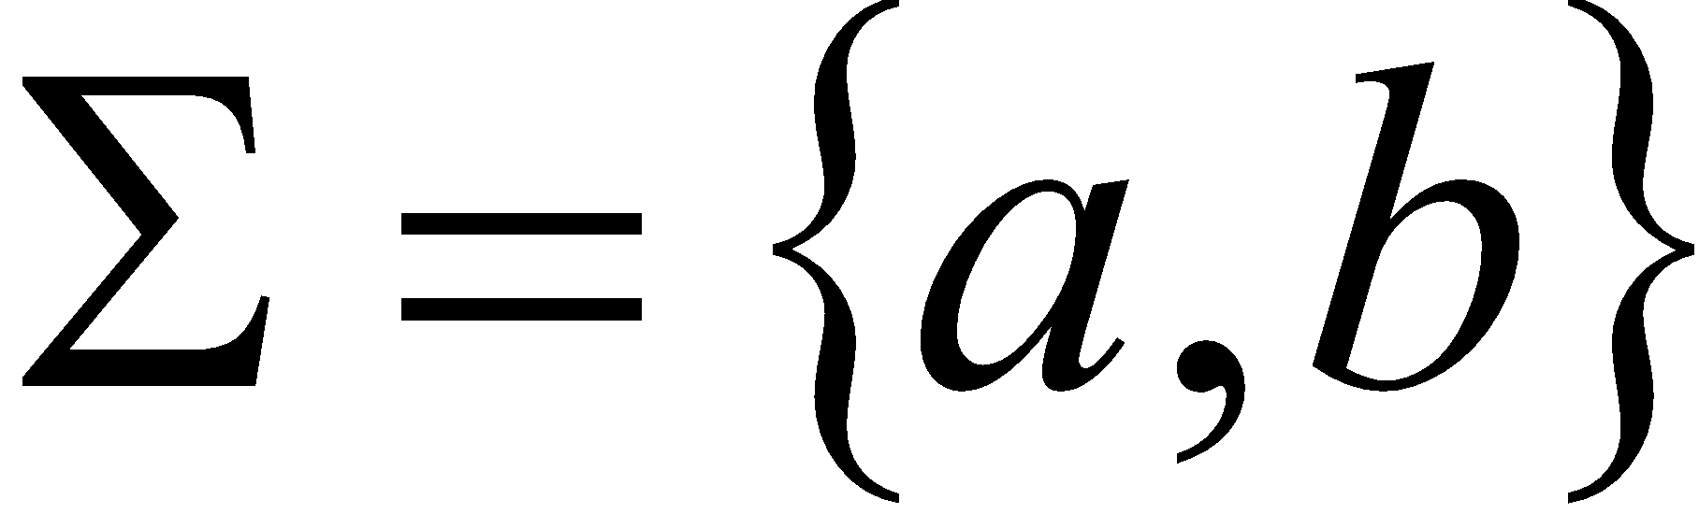
Input Alphabet
:the input alphabet never contains
Example

Slide 33
Initial State
Example

Slide 34
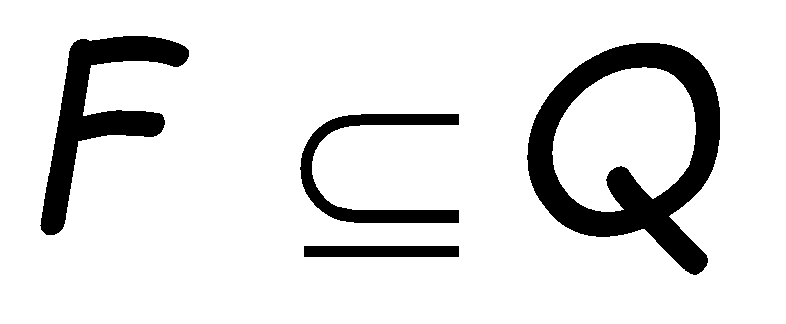
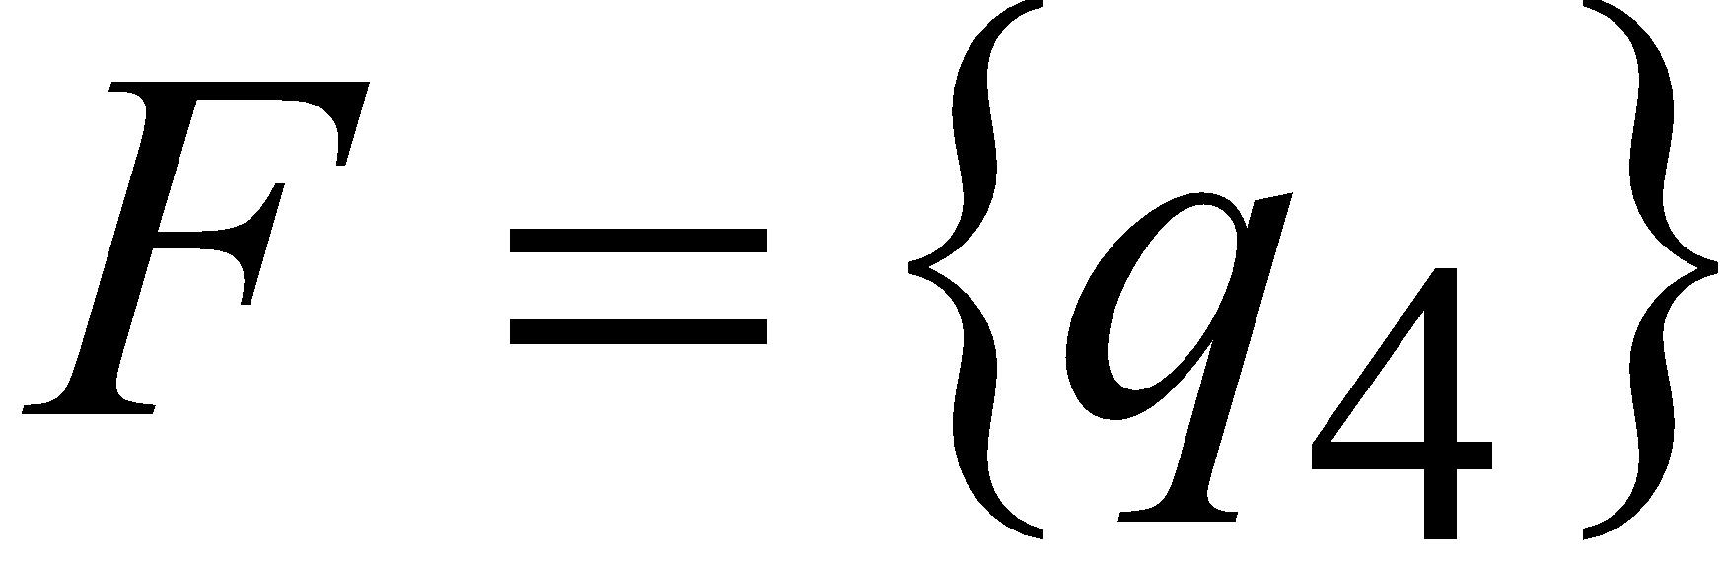
Set of Accepting States
Example

Slide 35
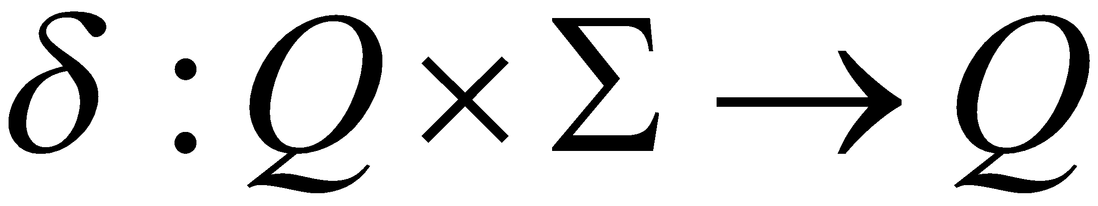
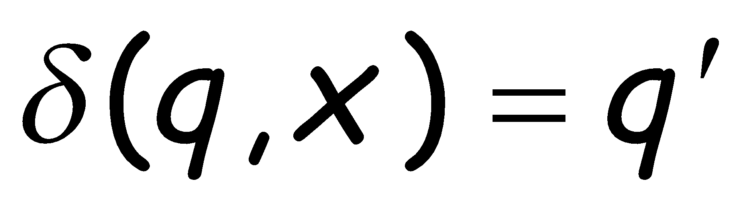
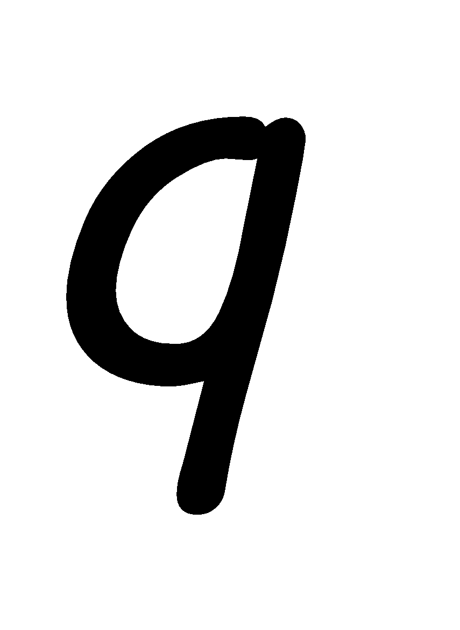

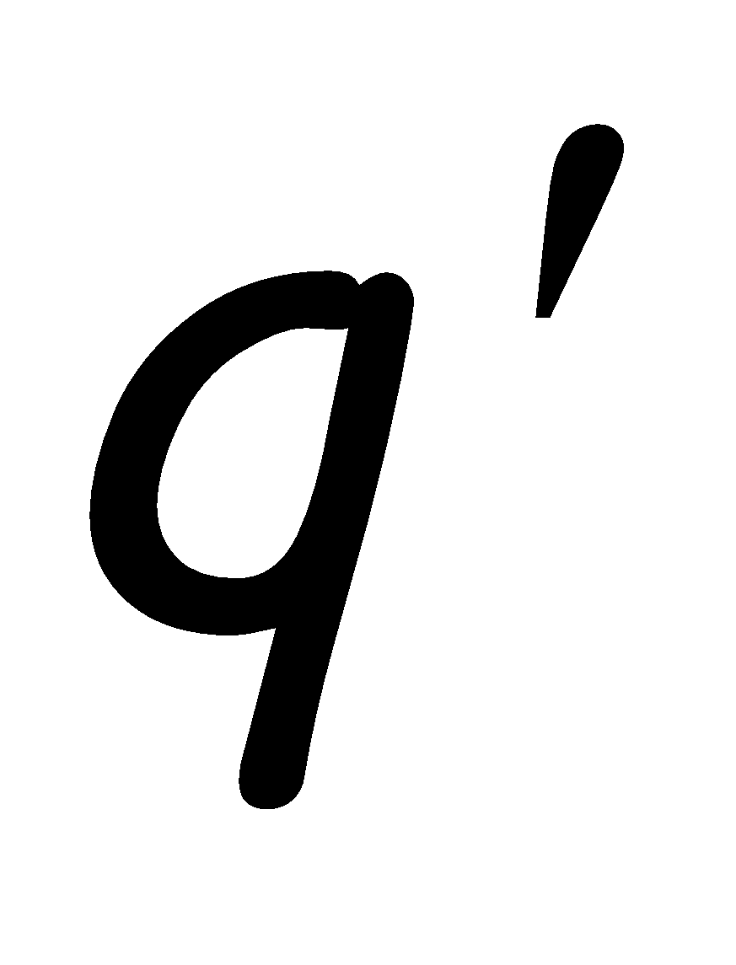
Transition Function
Describes the result of a transition
from state with symbol

Slide 36
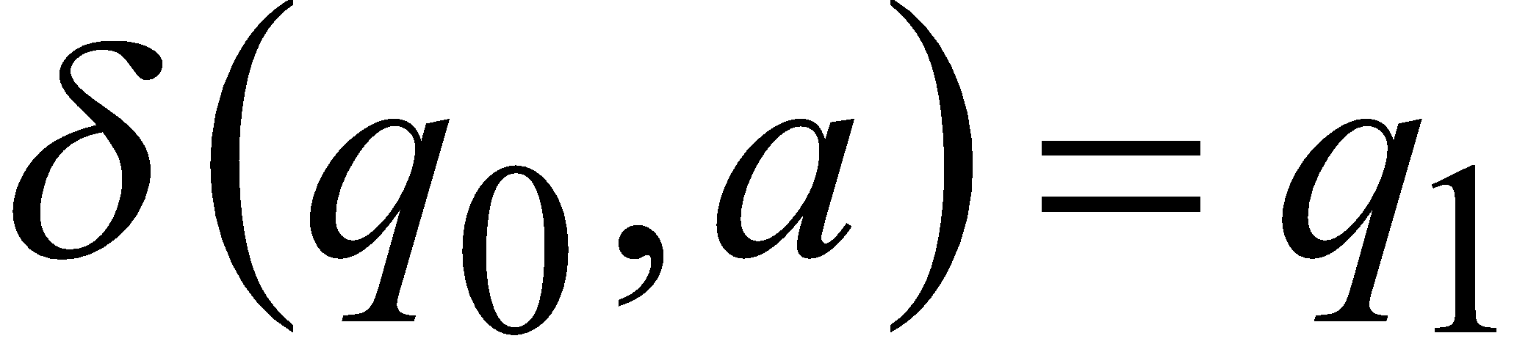
Example:

Slide 37
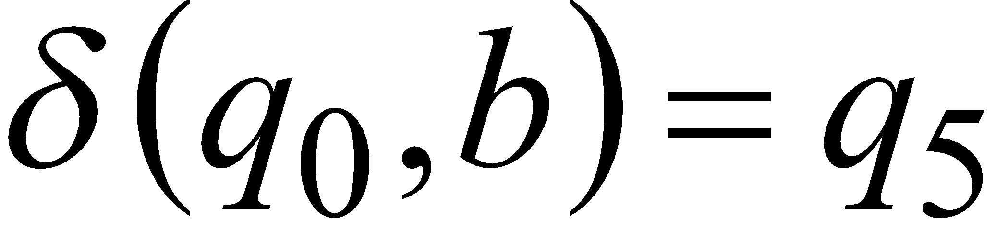

Slide 38
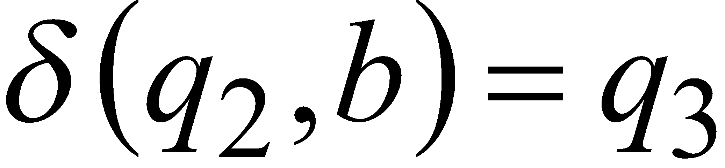

Slide 39
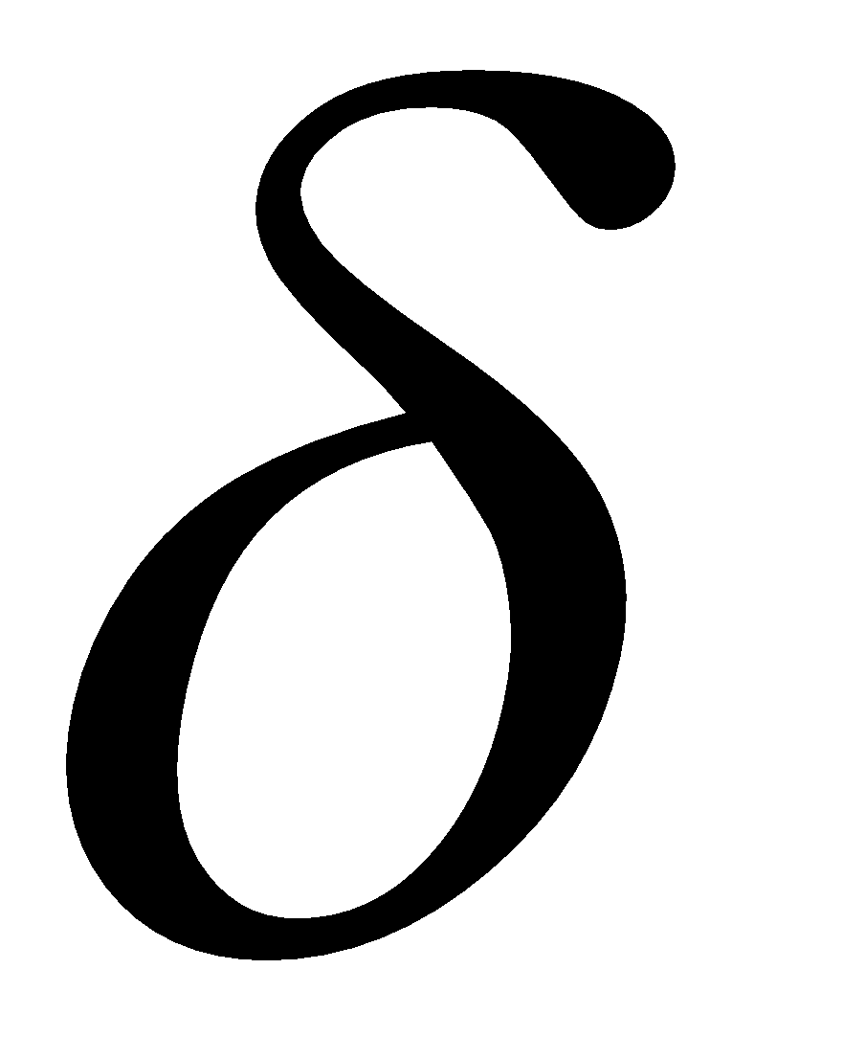
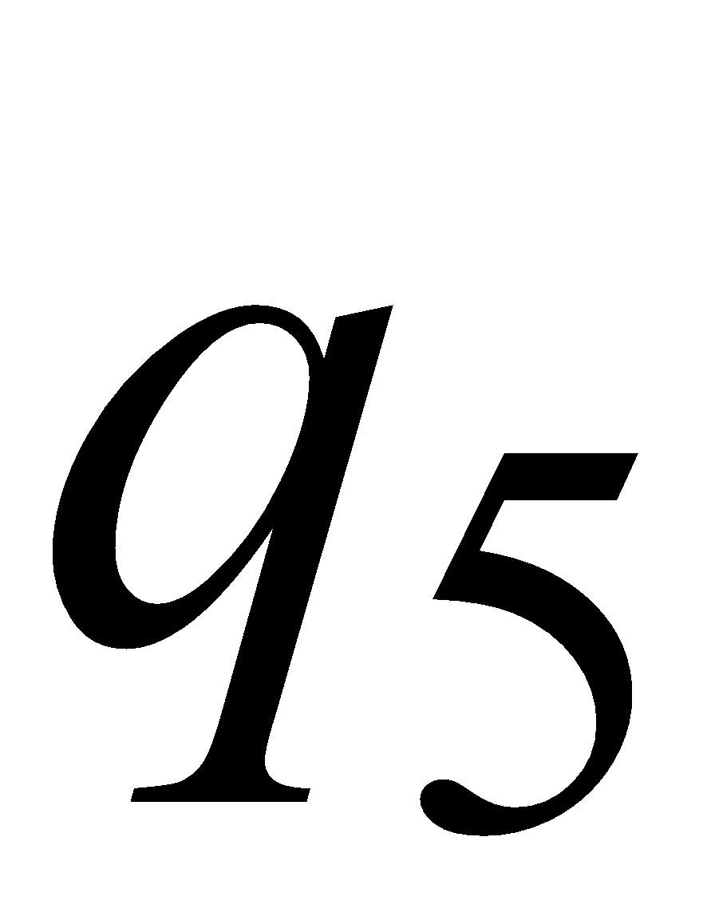
Transition Table for
symbols
states

Slide 40
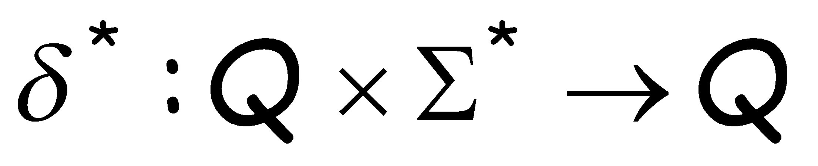
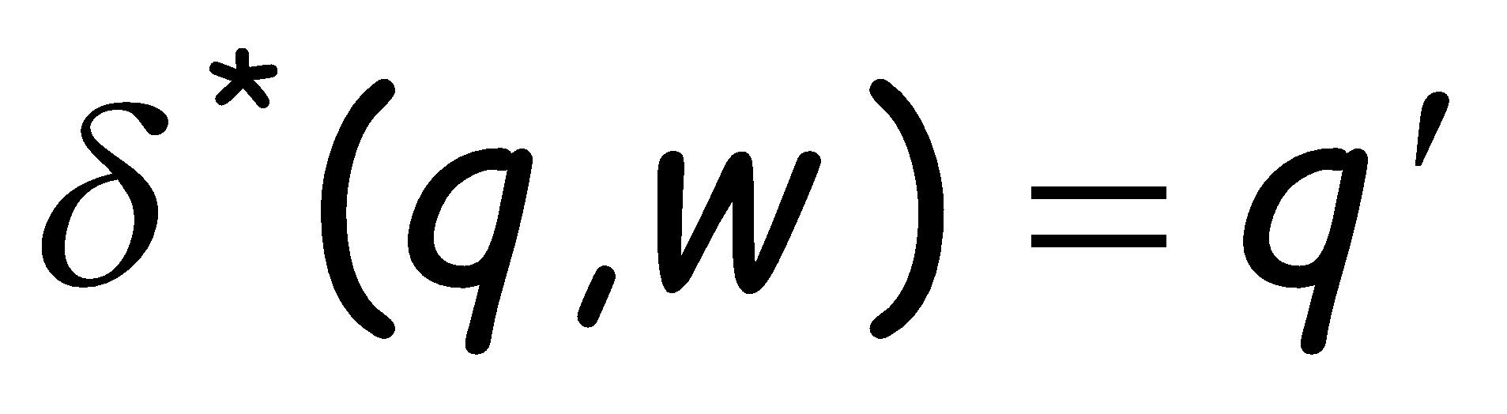

Extended Transition Function
Describes the resulting state
after scanning string from state

Slide 41
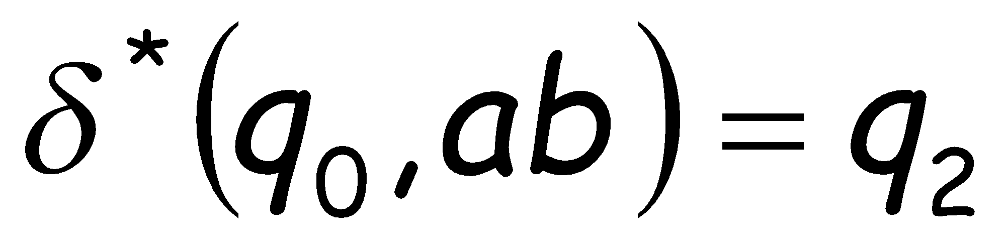
Example:

Slide 42
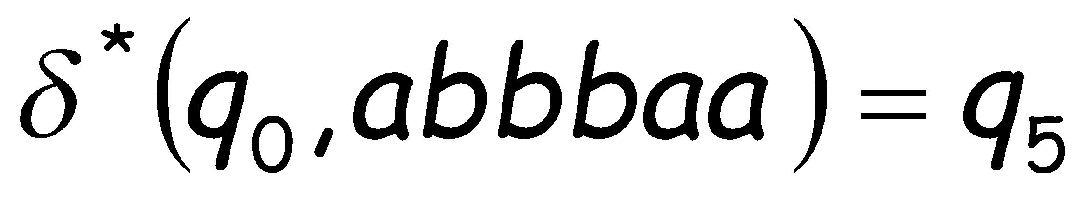

Slide 43
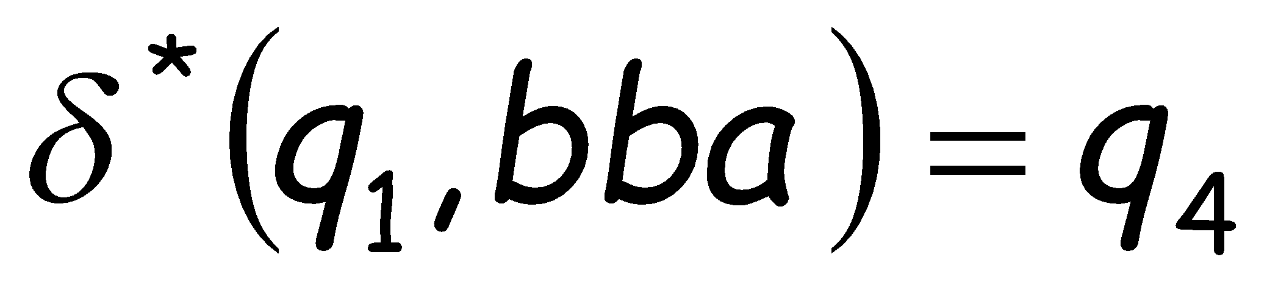

Slide 44
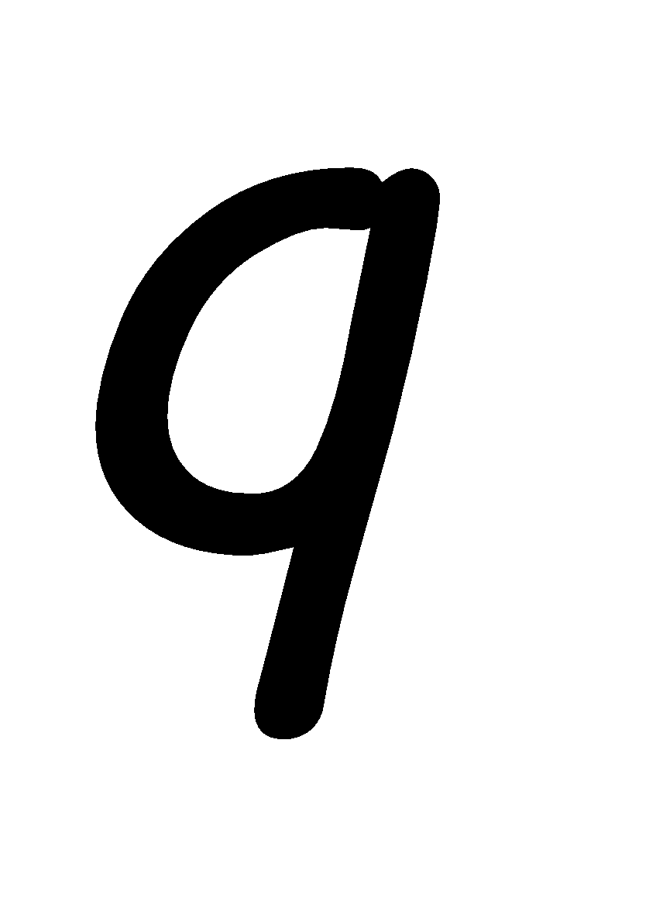
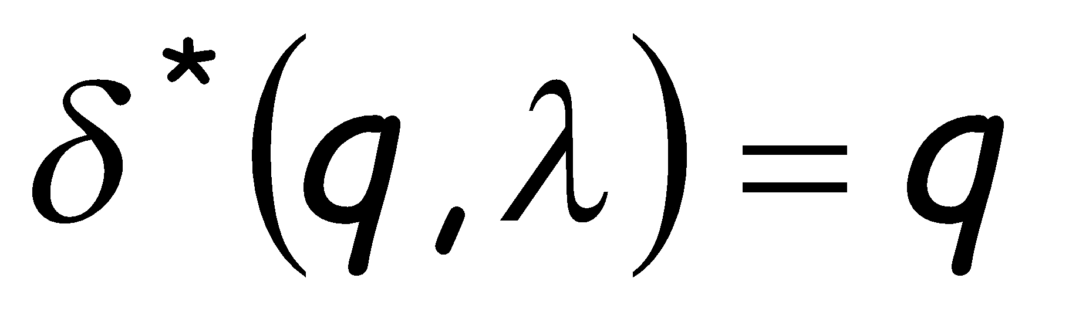
Special case:
for any state

Slide 45
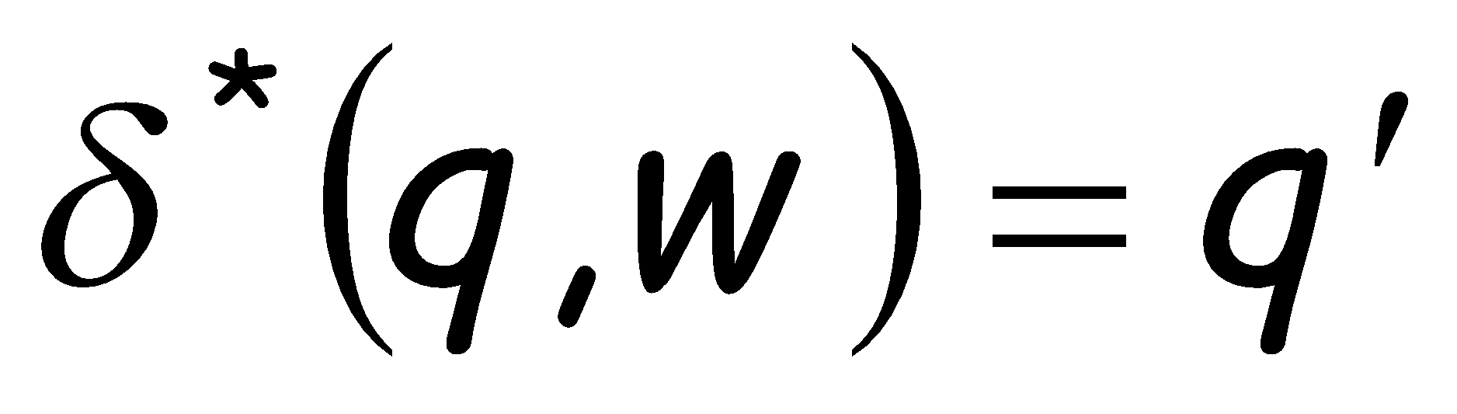
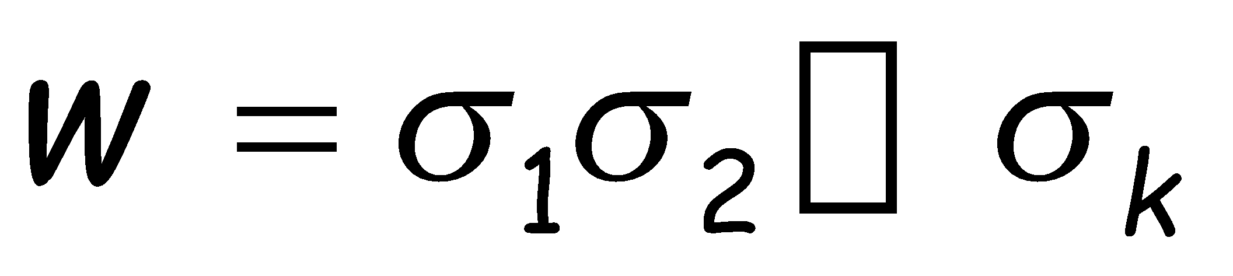
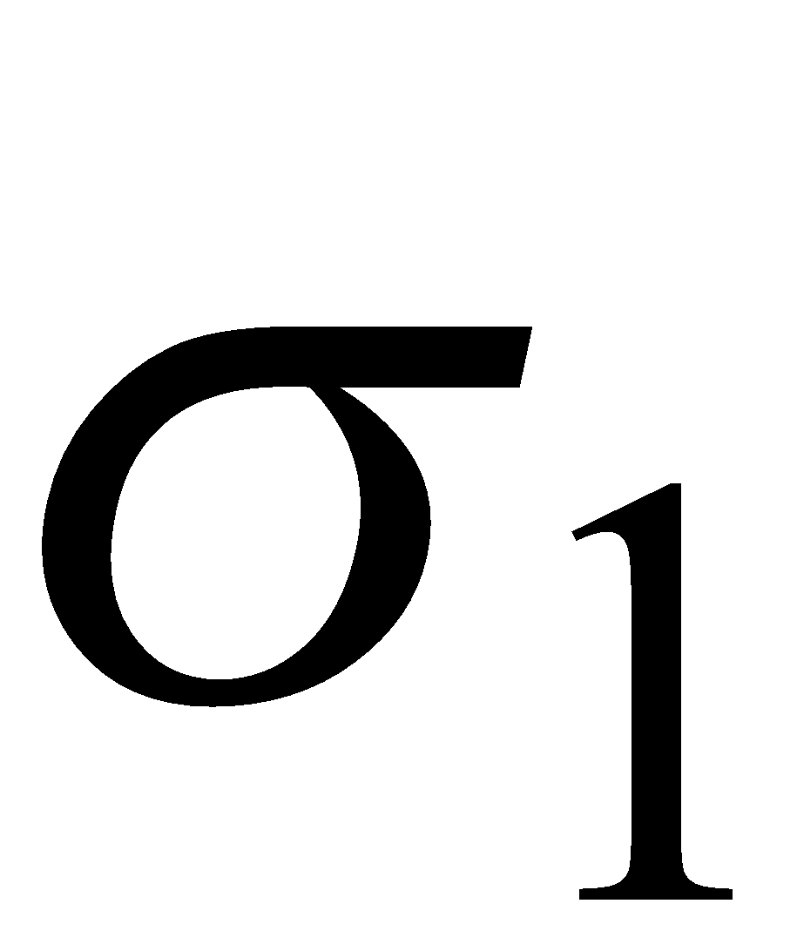
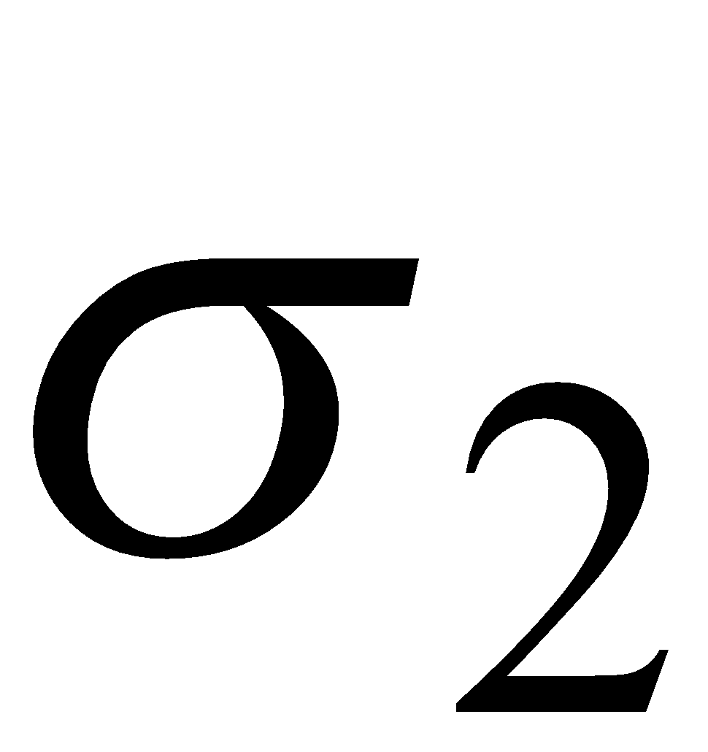
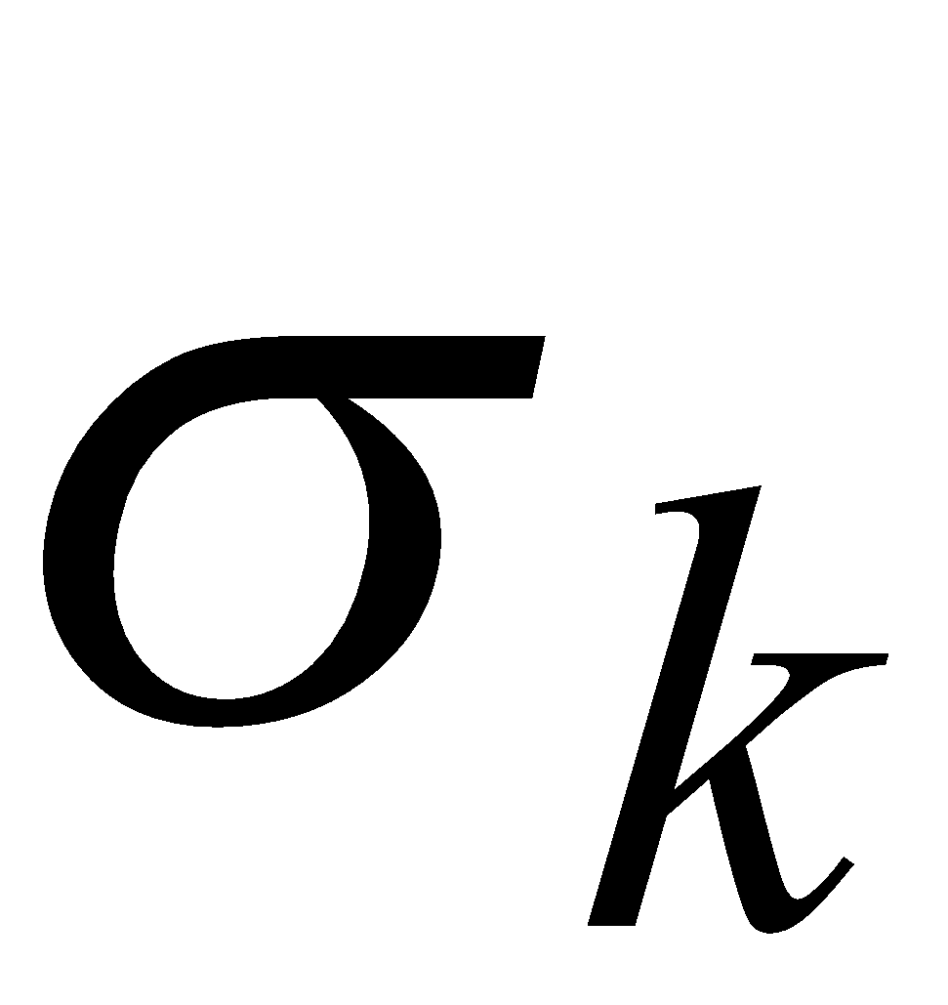
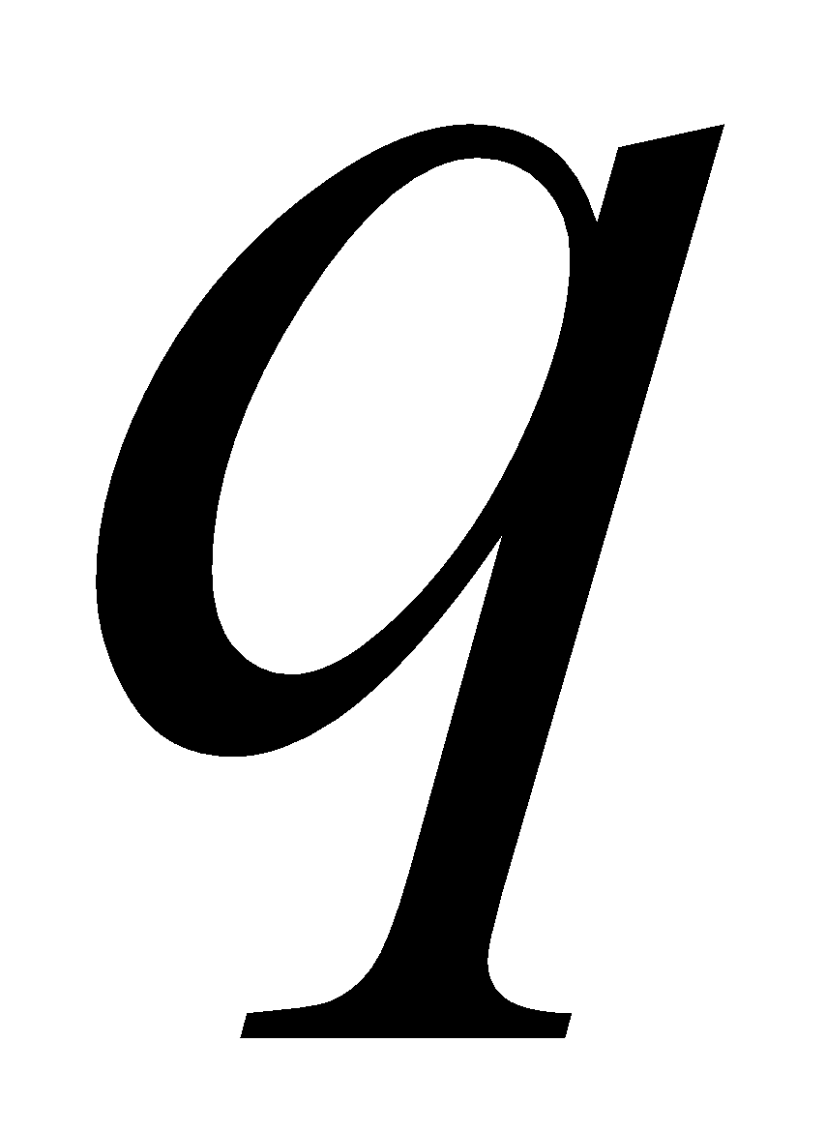
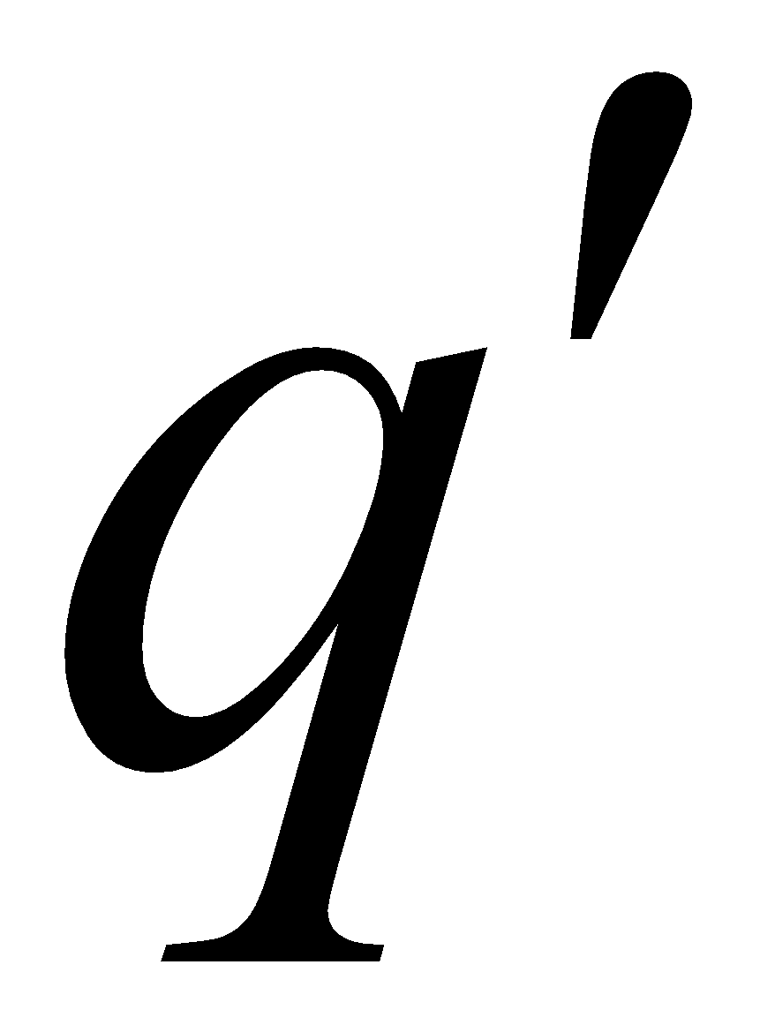
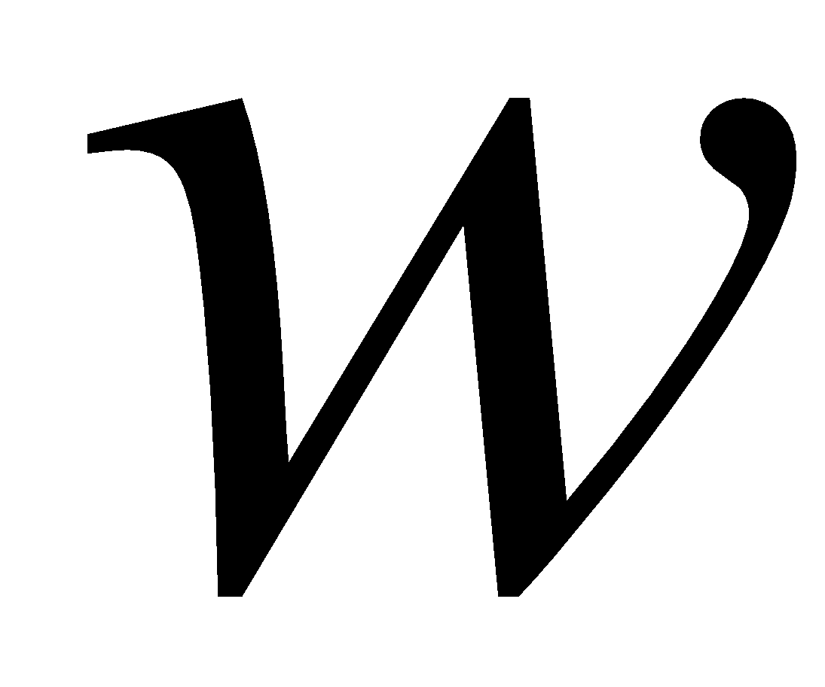
In general:
implies that there is a walk of transitions
states may be repeated

Slide 46

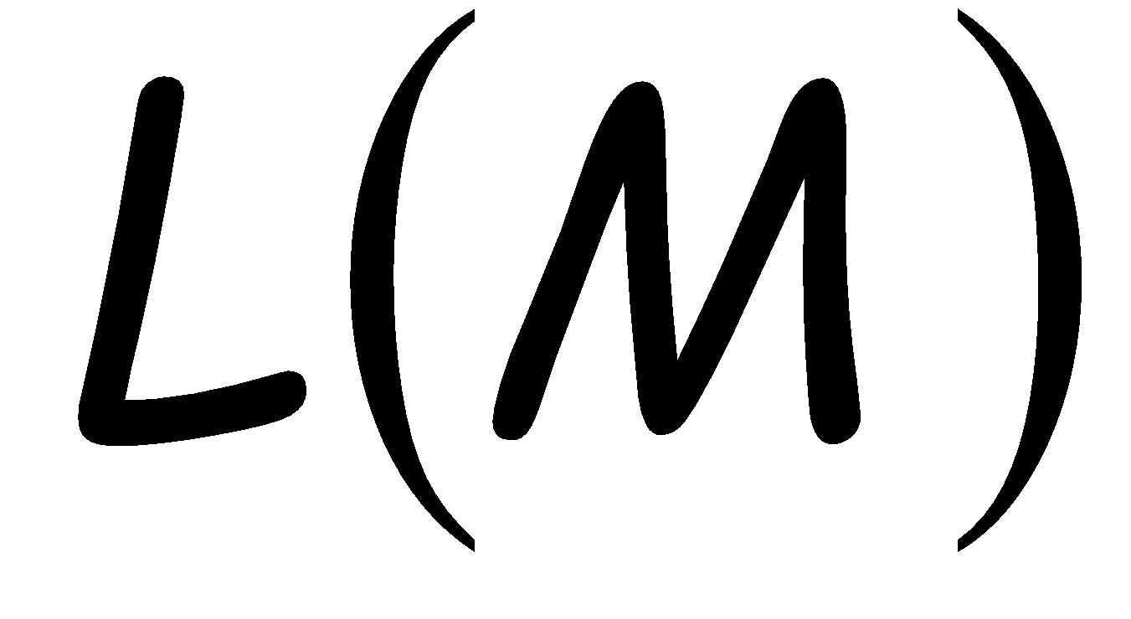


Language Accepted by DFA
Language of DFA :
it is denoted as and contains
all the strings accepted by
We say that a language
is accepted (or recognized)
by DFA if

Slide 47




For a DFA
Language accepted by :

Slide 48



Language rejected by :

Slide 49




More DFA Examples
Empty language
All strings

Slide 50

Language of the empty string

Slide 51


= { all strings with prefix }
accept

Slide 52







= { all binary strings containing
substring }

Slide 53
= { all binary strings without
substring }

Slide 54


Slide 55



Regular Languages
Definition:
A language is regular if there is
a DFA that accepts it )
The languages accepted by all DFAs
form the family of regular languages

Slide 56








Example regular languages:
{ all strings in {a,b}* with prefix }
{ all binary strings without substring }
There exist automata that accept these
languages (see previous slides).

